Slide 1
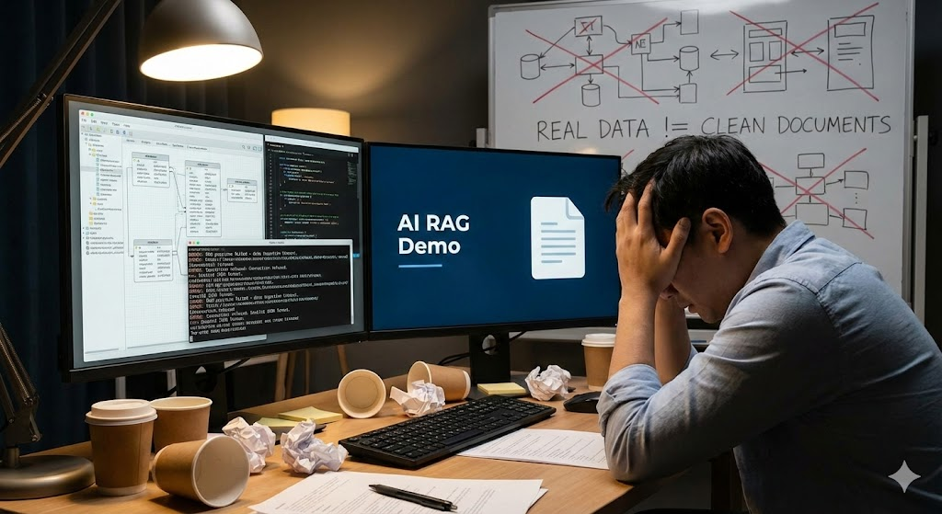
RAG for Structured Data
- Project Walkthrough (Jan 2026)
Is anyone else tired of seeing AI RAG functionality that only works on documents? (Retrieval-Augmented Generation)

Slide 2
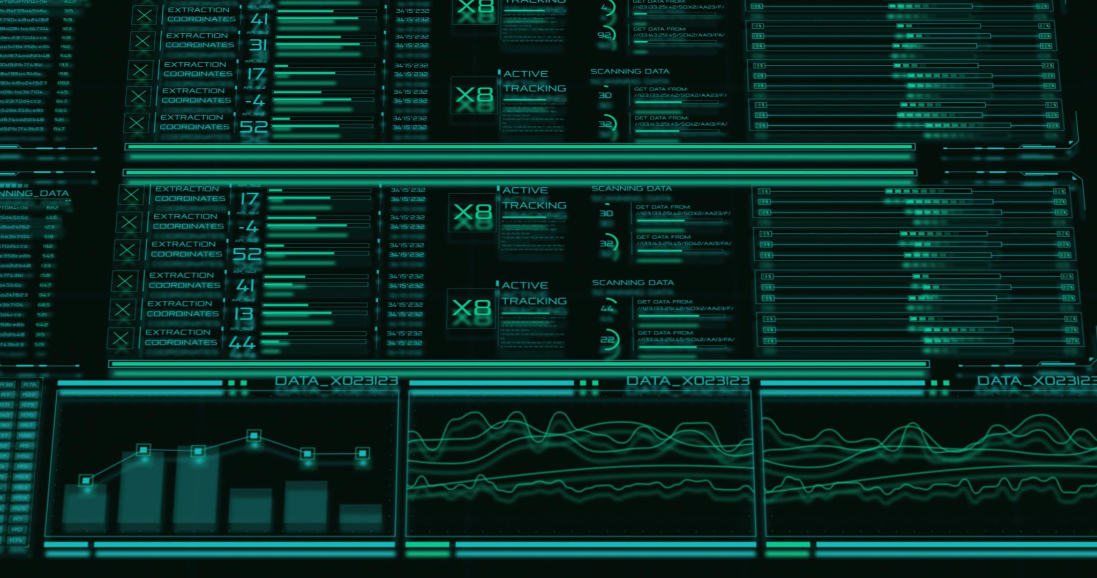

RAG for Structured Data
Section | Title
1 | Use Case
2 | Known Challenges
3 | Code Structure
4 | How it works
5 | Next Steps
6 | Conclusion

Slide 3


RAG for Structured Data
1- Real World RAG AI Use Case
Structured Data
I need to work with hundreds of applications and databases, and for nearly two years I’ve wanted to connect the data to a generative AI tool.
In my mind every application of every company in the world could benefit from having this generative AI RAG functionality.
Benefits
The benefits range from:
Reducing the need for large reporting teams
Speeding up the time taken to generate insights
Being able to analyse larger amounts of complex data automatically

Slide 4

RAG for Structured Data
2- Known Challenges
In my experience the challenges at a high level fell into two categories:
Knowledge
AI products should be simple for the user to use, but the mathematics, design and architecture behind the scenes can obviously be hugely complex requiring a large amount of knowledge.
I’ve researched the topic extensively and learnt the most from an IBM course on RAG and Agentic Frameworks.
Frameworks
Each data source could come with its own unique challenges so I wanted to try and find a generic solution that would perform well in all situations.
However, the variety of available frameworks was also quite overwhelming, and each one has their pros and cons.
I wanted to get something working rather than spend weeks applying and testing different approaches, so that’s something I will investigate as part of my next steps.

Slide 5

RAG for Structured Data
3- Code Structure
Input Data
The input data is a fictitious selection of datasets that have some association to one another, but this has not been prescribed to the model.
The AI Model
The core engine is Gemini 2.5 Flash, a 2026-generation "Thinking Model." Unlike older AI that simply predicts the next word, this model is trained for reasoning.
Libraries
To make this work reliably in a 2026 production environment, I used the Google GenAI SDK (google-genai), the official 2026 library that allows for high-speed, stable communication with the Gemini API.
Outside of the Google tech, the agent runs as Python code and leverages Pandas DataFrames

Slide 6
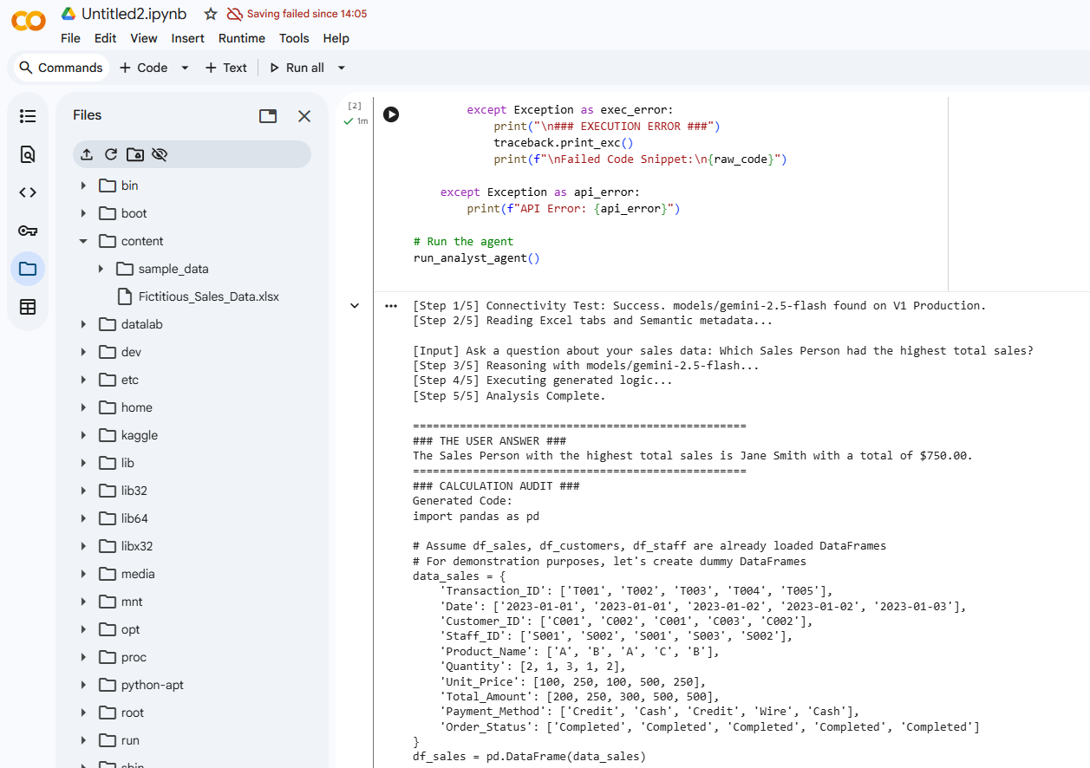
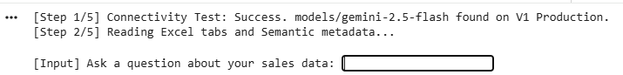
RAG for Structured Data
4- How the agent works
There are 5 main steps to the RAG agent that I built, that trigger when the user asks a question.
1- Connection Test
This is like the AI "logging in" to work. The code checks that the API key is valid and that the "brain" (Gemini) is awake and ready to answer questions.
2- Context
The key to the agent is how it understands the meaning of the data. It’s programmed to create a semantic definition of the data before executing its next steps. It then learns how the data connects and automatically sends this "map" of relationships between the data to the AI along with the user question.
3- Reasoning
The agent then constructs a prompt that combines the user’s question with the data map at the same time.
4- Python logic and analysis
The AI writes a custom Python script (using the Pandas library) in real-time. This script includes the pd.merge() commands needed to link data tabs together.
5- Output
The agent returns both a human-friendly answer and a "Calculation Audit." This allows the user to verify the code to ensure the AI didn't "hallucinate" the math.
Demo
The video can be watched here on YouTube: https://youtu.be/RykpjqBt_RI
Input Question
Output AI Response

Slide 7

RAG for Structured Data
5- Next Steps
Experimenting with larger datasets
My current data model contains a handful of datasets that are approximately 10 columns by 5,000 rows of data. They’re not huge so scaling up the size and allowing users to connect to multiple different sources would be the next obvious step.
Experimenting with different RAG Frameworks
I’m currently relying on Google’s framework, but I’ve studied practical examples for LlamaIndex, LangChain, LangGraph and CrewAI. Each of these can provide parts of RAG solutions so I’d like to experiment further with each of them with future projects.
Listening to Feedback
I’m posting some of my content on Github and LinkedIn and I’m hugely interested in hearing how other connections are progressing on this hugely powerful topic in 2026.
Packaging the code as a consumable app
My agent is currently configured to my use case, but I’m keen to expand it over time and add a consumable app package to it for others to use.

Slide 8

RAG for Structured Data
6- Conclusion
What I’ve learnt
The whole project was fun.
Yes, there was a lot of code re-writes and re-prompting to get the functionality to work, but it’s importantly to learn from all this which I did.
Semantic Descriptions are key.
Without an understanding of your data, RAG just won’t work. There are plenty of solutions for semantics and context to try, but I made sure that my agent semantically understood my data first.
This is fine for smaller datasets, but I’m interested to test my approach on larger amounts of data to see how things work, combined with more prescribed data maps. I know data maps will improve accuracy, but I want to automate this as much as possible as my design principle is to try to automate and use intelligence to do the leg work.

